Slide 1


Proposal – TalkyHome Using WebApi like sinric , Google home, Alexa, Assistant, and Manual control
Mini-Project/ Electronic Design workshop (Hardware Part)
EC-681 April-2024
Maulana Abul Kalam Azad University of Technology (formerly known as West Bengal University of Technology )
ROHIT PAL (MAKAUT Roll No :14800321064)
SAHELI DAS (MAKAUT Roll No :14800321086)
SOHAM MAJHI (MAKAUT Roll No :14800321077)
Under the mentorship of
PROF. ANUPAM PATRA
(Assistant / Associate Professor, Dept of ECE, FIEM)
Department of Electronics & Communications Engineering
Future Institute of Engineering & Management
Sonarpur Station Road, Kolkata-700150
2024

Slide 2

INTRODUCTION OF TalkyHome :
Our Project TalkyHome is the wireless and remote control of different aspects of a living space like lighting, temperature, security, entertainment, etc. It performs with the help of connected smart devices and appliances that use communication technology like WiFi, Bluetooth and Ethernet, to share data and facilitate the efficient management of power consumption.
It has advantages like :
Cost-effective
Self-sufficient
Eco-friendly
Development of smart appliances
Integration of Smart home devices
Increased efficiency, control, and customization

Slide 3
OBJECTIVE: Home devices connected to the Internet are an important part of the Internet of Things (“IoT”). In this home automation system, fans, light bulbs, connectors, etc. are connected to the relay module to control four appliances. Since these devices are configured with API (Sinric Pro), the software part of the project will recognize the device you are trying to set up. Then you can connect the API to the Google Home app to send commands, and the NodeMCUE SP8266 WiFi module will receive commands wirelessly from your smartphone over the internet..
Prototype Home AutomationThe system controls devices like fans and lights through simple button presses, eliminating reliance on traditional, less efficient machines.
API and Wireless ModulesAPIs and wireless modules enable communication between NodeMCU and Relay modules, allowing wireless control of connected appliances.
Integration with Google Voice Assistant The Sinric Pro platform connects with Google Voice Assistant, enabling users to control up to four appliances remotely via voice commands.
Technological Framework The project employs Embedded Systems and cross-platform APIs to facilitate communication over WiFi, reducing the need for sensor-based controls.
Keywords: Automation, ESP8266, Application Programming Interface(API), Embedded Systems, Internet of Things, Cloud.

Slide 4

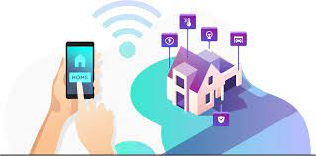
Cost-effective:
Home automation appliances have a longer life cycle than the regular device.
Hence this consume less power and saves money.
Self-sufficient:
The home automation technologies come with the option of
running on sustainable sources of energy like wind or solar
power and even water harvesting.
Eco-friendly:
The smart home appliances consume a minimum amount of power. This is because they use stored user data to modify the output. This means a fair amount of energy is saved.

Slide 5
LITERATURE REVIEW:
Architecture and Features of Sinric Pro:
Sinric Pro operates on a cloud-based architecture, ensuring seamless communication between devices and users.Key features include real-time device status, event-based automation, and integration with multiple voice assistants.It offers WebSockets for low-latency communication and supports various programming languages.
Basic principal:
IoT in home automation involves connecting various home devices to the internet for remote monitoring and control.It enhances convenience, energy efficiency, and security in homes.Key components include smart devices, IoT platforms, and user interfaces for control.
Applications in Home Automation
Sinric Pro is used to create smart lighting systems, automated security setups, and voice-controlled devices.It allows users to set up custom routines, schedules, and triggers for automated tasks.The platform supports smart home hubs, enabling interoperability between different brands and device types.
Challenges and Limitations
Reliance on Cloud Services: As a cloud-based platform, Sinric Pro requires a stable internet connection, and downtime can affect automation.Security Concerns: The use of IoT in home automation raises security and privacy concerns, such as unauthorized access and data breaches.Complexity for Non-Technical Users: Setting up IoT-based home automation can be complex, especially for users with limited technical knowledge.

Slide 6
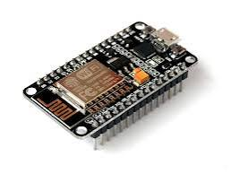
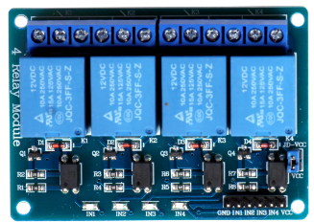

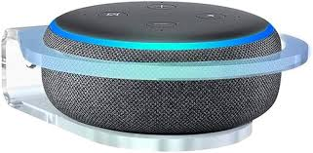
COMPONENTS REQUIRED AND ITS SPECIFICATIONS:
NodeMCU (ESP8266)
SPECIFICATION: NodeMCU, built on the ESP8266, provides Wi-Fi connectivity, GPIOs, PWM, and ADC capabilities for versatile IoT-based home automation TalkyHome.
4-channel 5V SPDT Relay Module
SPECIFICATION: Its Consist four single-pole, double-throw relays, controlled by 5V signals for switching high-voltage loads
Manual Switches or Pushbuttons
SPECIFICATION: used for control circuits, often for toggling or activating functions in electronic systems Manually Also
Amazon Echo Dot (optional)
Google Nest Mini (optional)
SPECIFICATION: Amazon Echo Dot and Google Nest Mini are compact smart speakers with voice assistants, enabling voice-controlled IoT automation in smart homes.

Slide 7
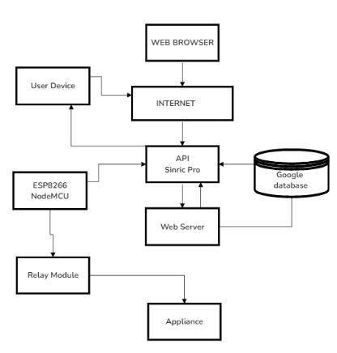
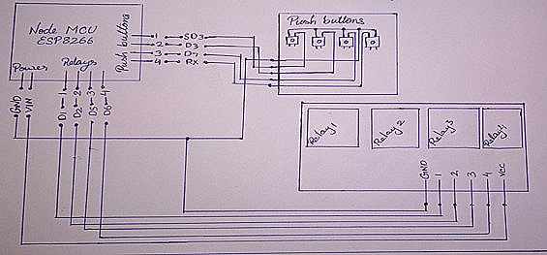
BLOCK DIAGRAM AND ITS DESCRIPTION:
SOFTWARE USED In this Project
We used Google Home app and Sinric Pro, Alexa, Home, GAssistant API and Arduino IDE as programming interface.
Sinric Pro
allows IoT integration with platforms like Amazon Alexa and Google Home. It uses REST API, token-based authentication, and JSON responses. Adding a switch device generates a unique ID, used to control an ESP8266 relay for smart home automation.
The Google Home
This app lets us set up and control Google Nest, Home devices,
It manages our TalkyHome Devices . and switches between multiple homes. Quick actions offer instant control of compatible devices and services.
FIG: Block Diagram Of IOT based TalkyHome using Senric Alexa and Google Assistant System Using ESP8266

Slide 8
OPERATION AND WORKING :
We can operate our TalkyHome via voice control, with an app interface, web API(Sinric Pro), and manual control. As we have set up the devices over API and written them in our program and programmed our NodeMCU accordingly, so, now we have successfully established our devices on the internet as software also in real time as circuitboards.
GOOGLE HOME,ALEXA AND WEB API (SINRIC PRO)
We once configure these devices over our API we can connect it to our Google Home app. Google home app provides a very exquisite feature for controlling devices which are setup over an API. So as soon as we connect Sinric Pro to Google home they share the data as it is. Once it gets connected we can see the devices in the Google home app, we set up earlier in our API as same as they were setup by us. Now we can tap on and off freom the app as well as from the browser with our web API.
VOICE CONTROL FUNTIONAL
TalkyHome is Google Assistant built-in, Now Google Home and assistant is able to answer to your commands. Without being connected to the internet, Google Home can't do a whole lot. While Google Home is a decent enough speaker, you can find better wireless speakers for less money if you don't plan on connecting to the internet. When you do connect Google Home to the internet, you unlock the functionality of Google Assistant. The way it works is you say "OK Google" or "Hey Google," and then talk to the device almost like you would talk to a person. When we say the command “turn on Relay One” it turns on the corresponding relay. NOTE: Google assistant accepts commands as they are being programmed to do if we set up the
device in our API with the name of Relay One only then google home identifies it as relay one.

Slide 9
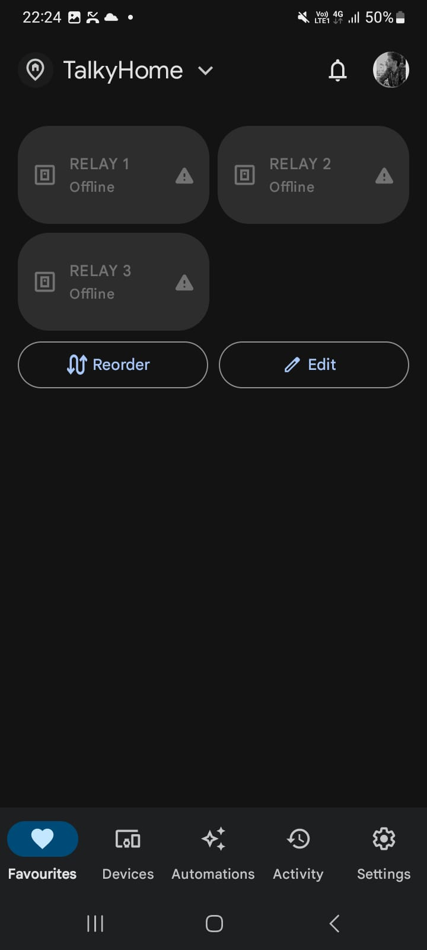
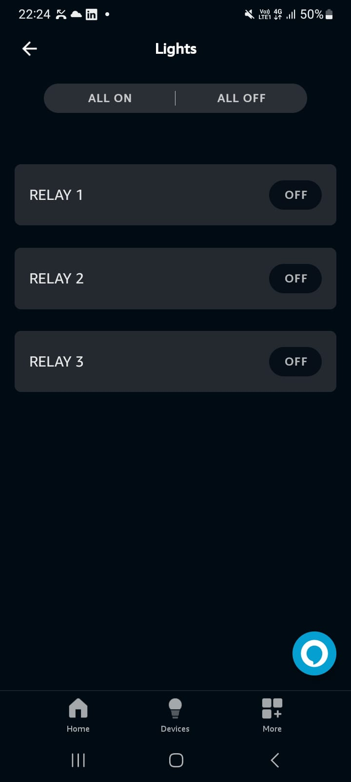
RESULT ANALYSIS
The process of the smart automation approach in this system was tested and put to implementation. The results turned out to be as per expectations. As the voice command was given to the Google voice assistant it was executed and gave promising results by turning on the corresponding device as requested by the user. In the first activity, the system was controlled over voice control while in the second activity the system was controlled with google home. The google home app allows us to connect to the API where we have configured our devices. \When we connect our API to google home, whatever the number and type of devices be set up in the API will be displayed as a controlling interface in the google home app.
GOOGLE HOME INTERFACE
ALEXA INTERFACE

Slide 10
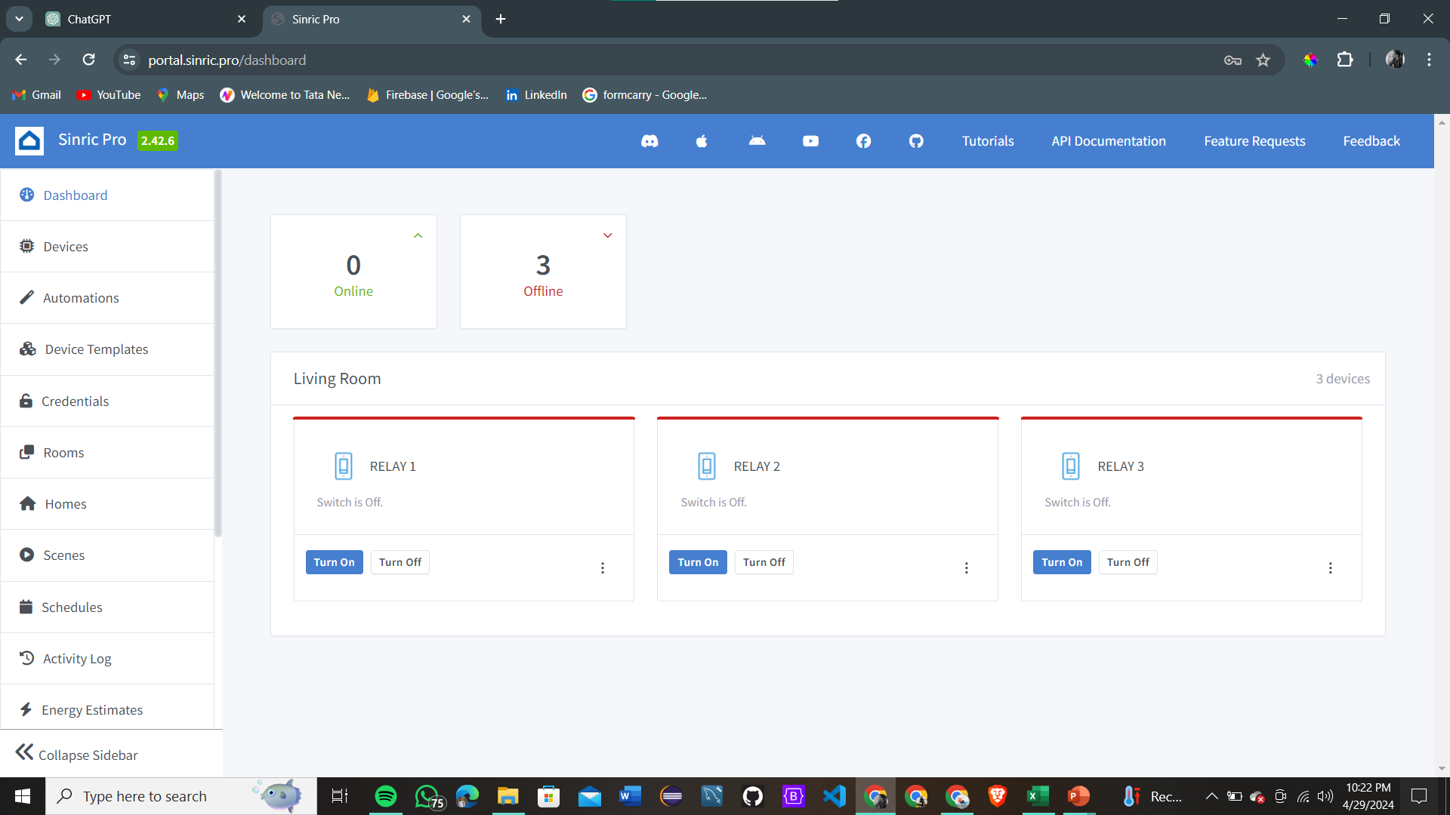
DATABASE OF THE WEBAPI OF OUR PROJECT TALKYHOME :

Slide 11
FUTURE SCOPE OF WORK:
In the future, home automation is definitely going bigger and better. The Internet of Things is already bringing a wide range of exciting, innovative solutions. Sensors in parking lots will indicate space availability. Users could make their favourite beverage with voice instructions, or instructions to the smartphone can close the blinds in the living room while residents are far away on vacation. There is no end to the possibilities of home automation. The most useful advantage is, however, the aspect of sustainability. Home automation works on the principle of sustainability, which encourages the wise use of resources.
SchneiderElectric India offers Home automation solutions with the latest technology that makes living easy and convenient. Their innovative solutions work towards efficient power consumption and cost-cutting.
Increased efficiency, control, and customization:
Artificial intelligence is set to make you lazy in the near future. Technology will become much more efficient and one will be able to control everything from volume to security from one central place. The devices will work automatically and you don’t need to waste your energy it will act upon user’s preferences. AI would revolutionize home by automatic threat detection and proactive alertness.

Slide 12
REFERENCES/BIBLIOGRAPHY:
International journal for research in applied science &engineering technology (ijraset) volume 6 issue iv, April 2018
Monika M Patel; Mehul A Jajal; Dixita B vataliya, Home Automation using Raspberry Pi. International Journal of Innovative and Emerging Research in Engineering Volume 2, Issue 3, 2015
Tomar, Ravi, Rahul Tiwari, and Sarishma. 2019. “Information Delivery System for Early Forest Fire Detection Using Internet of Things.” in Communications in Computer and Information Science. Vol. 1045. Springer, Singapore.
Internet of Things in Home Automation and Energy Efficient Smart Home Technologies Simon G. M. Koo Department of Computer Engineering, Santa Clara University, CA 95053, USA

Slide 13
Acknowledgement
It is a great pleasure to express our deepest gratitude and indebtedness to our mentor(s), PROF. ANUPAM PATRA Department of Electronics and Communications Engineering, Future Institute of Engineering & Management, Kolkata for his/her supervision, constant help and encouragement throughout the entire period.
We are also thankful to all other faculty members and technical staffs of the department for their help and support.
ROHIT PAL
SAHELI DAS
SOHAM MAJHI
THANK YOU

